Slide 1
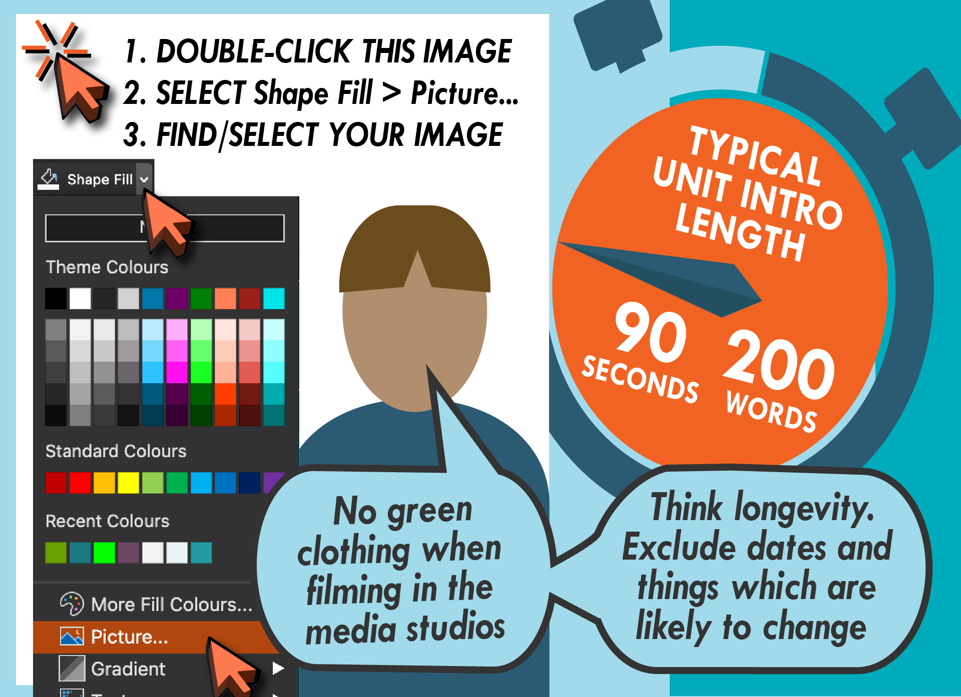

Slide 2
About me
Build community and trust
Be personal e.g. “I like wombats”
Reinforce who you are

Slide 3
About the unit
How will it help your students
Why invest the time and energy?
e.g. foundation skills necessary for success
Reveal what you like about your unit

Slide 4
Assessments
Be brief — Avoid too much detail
No transient information like dates
Remind students where they can find the unit outcomes and assessment overview

Slide 5
Enjoy this unit!
Building rapport and develop social presence
Project your personality
No need to thank — You are the info giver

