Slide 1

Copyright
Some of this material may have been copied and communicated to you in accordance with section 113P of the Copyright Act 1968 (Act)

Slide 2
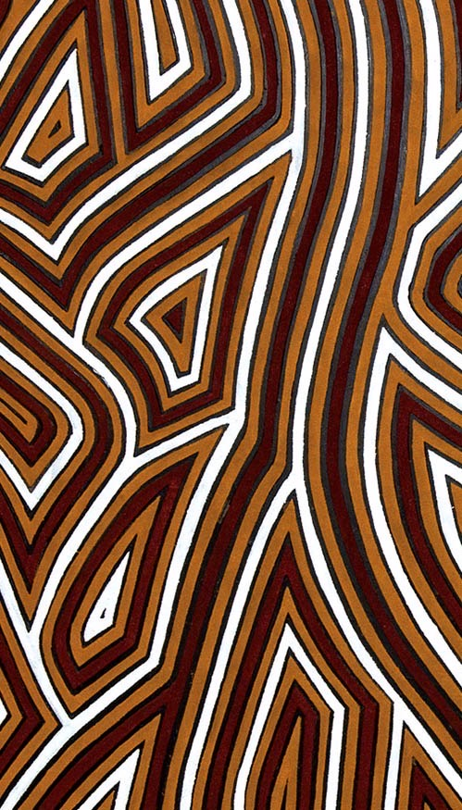

Acknowledgement of Country The University of New England acknowledges that we are on Country of the Anaiwan people. UNE respects and acknowledges that its people, programs and facilities are built on land, and surrounded by a sense of belonging, both ancient and contemporary, of the world's oldest living culture. UNE also acknowledges the Gumbaynggirr, Kamilaroi, and Dhunghutti nations and pays its respect to the Elders, past and present, of these nations.
Pictured: Warwick Keen “Always was, always will be” 2008
Gifted by the artist to UNE in 2008

