Slide 1
Copyright
Some of this material may have been copied and communicated to you in accordance with section 113P of the Copyright Act 1968 (Act)

Slide 2
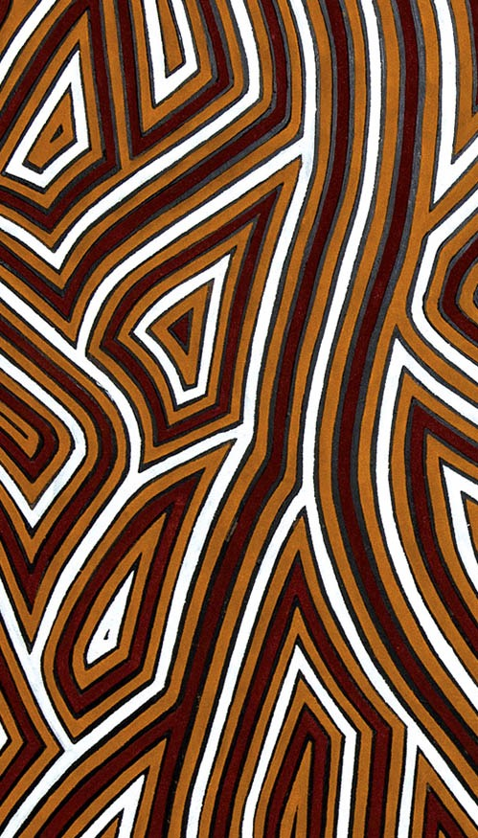


Acknowledgement of Country
In the spirit of reconciliation, the University of New England respects ​and acknowledges that its people, programs and facilities are built ​on land, and surrounded by a sense of belonging, both ancient and contemporary, of the world's oldest living culture. In doing so, UNE values and respects Indigenous knowledge systems as a vital part ​of the knowledge capital of Australia.​
Pictured: Warwick Keen “Always was, always will be” Gifted by the artist to UNE in 2008

